Slide 1
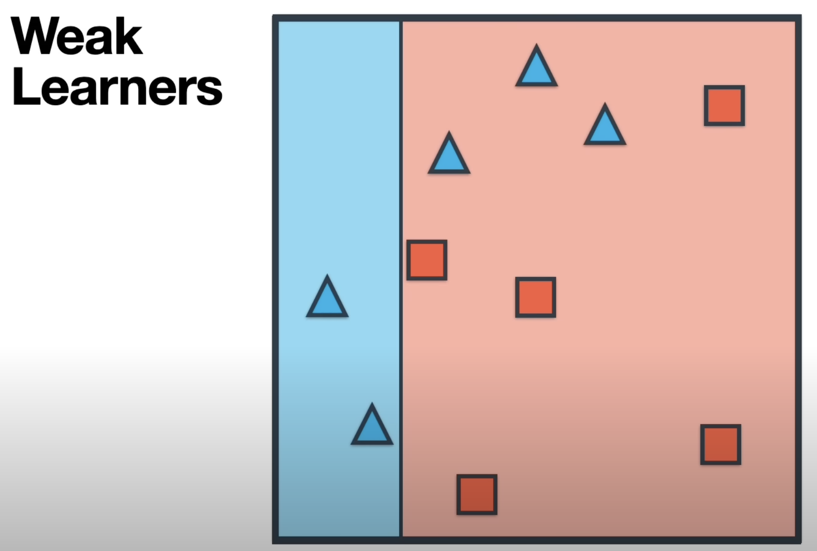
Gist of AdaBoost
Let's build some simple classifier, we are going to call this as weak learners
Let’s say it’s vertical line over here which classifies everything to its left as blue triangle and its right as a red square, this classifier is good but not perfect, we are going to need to build some more and this is the idea – each learners is going to focus on the weakness of the previous ones
What are the weakness of this classifier, as you see from this it got most of the points correct but it made three mistakes which are highlighted in yellow box which is 3 blue triangle that are incorrectly classified as red squares
So we are going to make sure next classifier focuses on those three points which incorrectly classified triangle as red squares

Slide 2
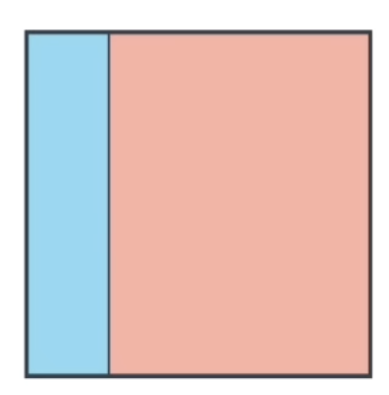
So, we are going to make sure next classifier focuses on those three points
Weak Learner 1
We are going to store this patter over here for later use
Weak Learner 1

Slide 3
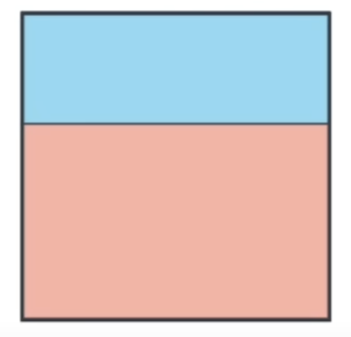
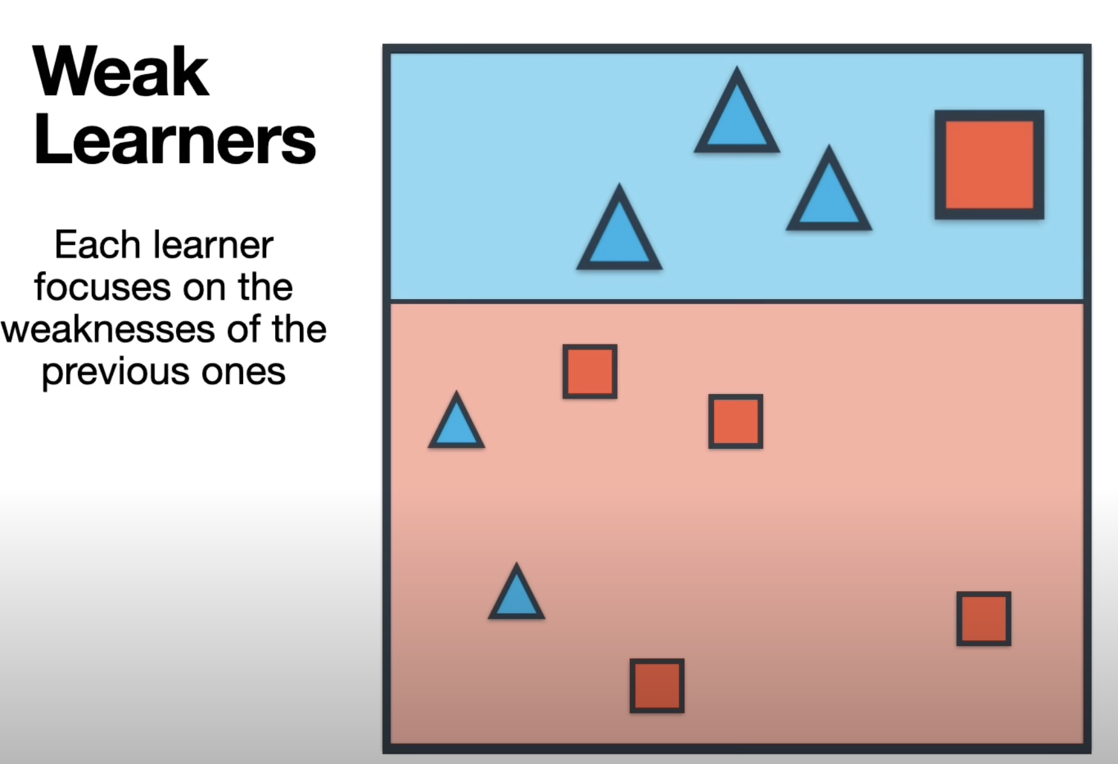
Now we are going to build a new Weak Learner 2 on this new Weighted Data set
Weak Learner 2
We are going to store this patter over here for later use
Weak Learner 2
Red Square over the top classified as Blue Triangle and there are 2 blue triangles here got classified as red squares.. So it made 3 mistakes but that’s okay.
Lets move on the build a new classifier (weak learner 3) on these same data sets these better get the big points correct… details on next slide

Slide 4
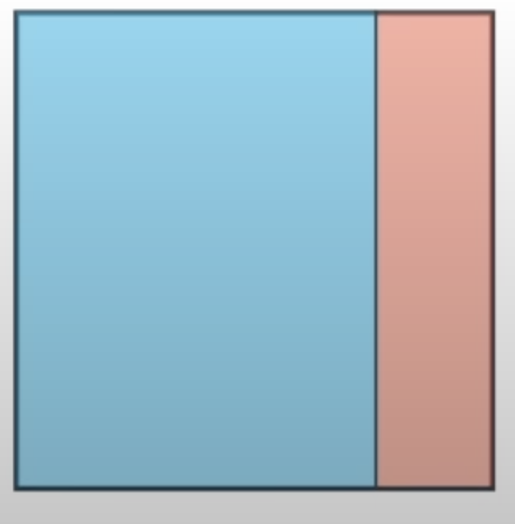
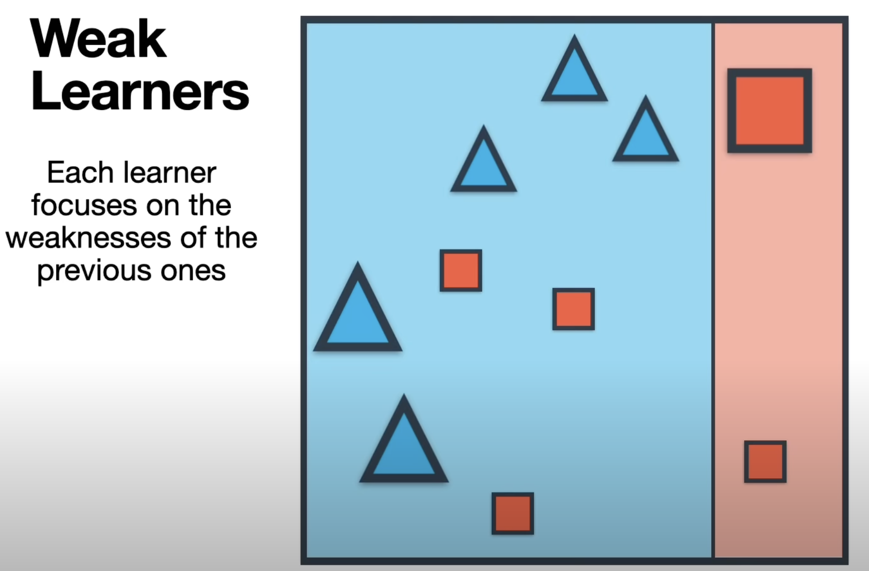
Weak Learner 3
We are going to store this patter over here for later use
Weak Learner 3
And this one could be this vertical line over here which classifies everything to the left
Our final step is just that we combine the three Weak Learners 1, 2,3 - details on the next slide

Slide 5
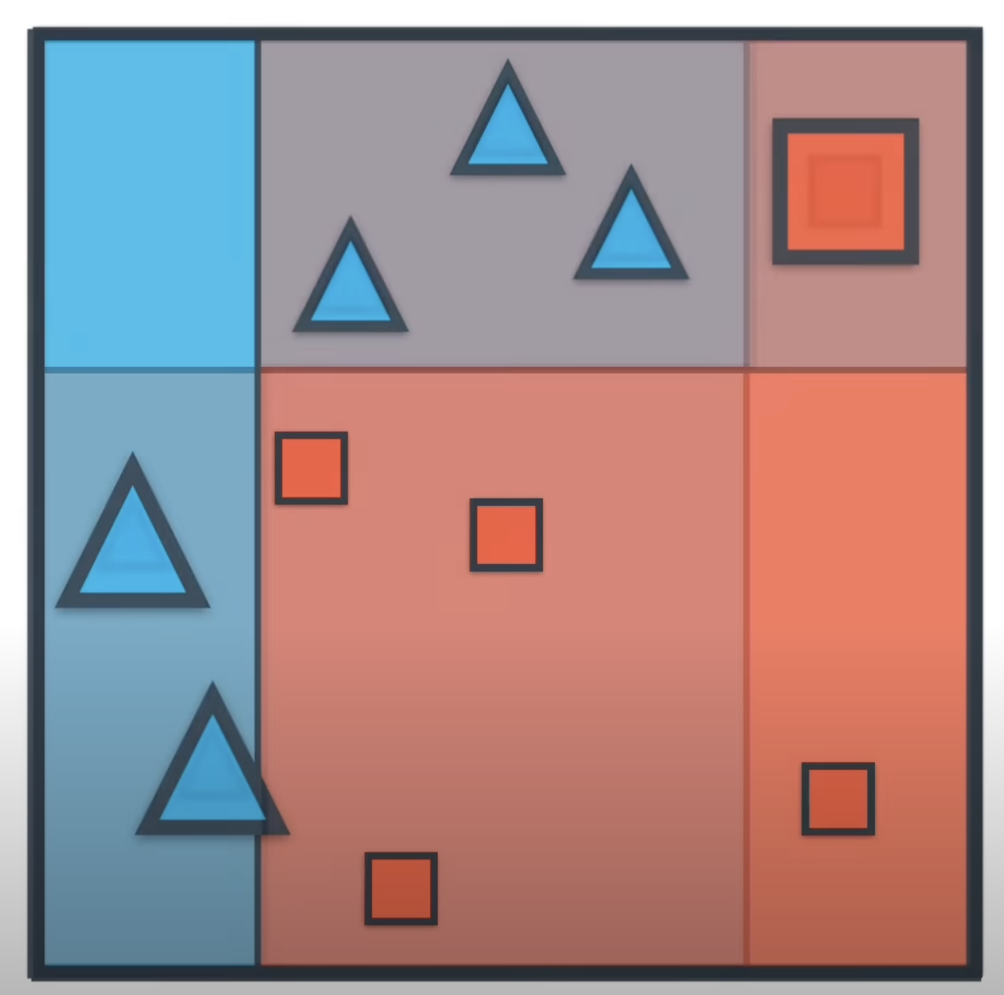
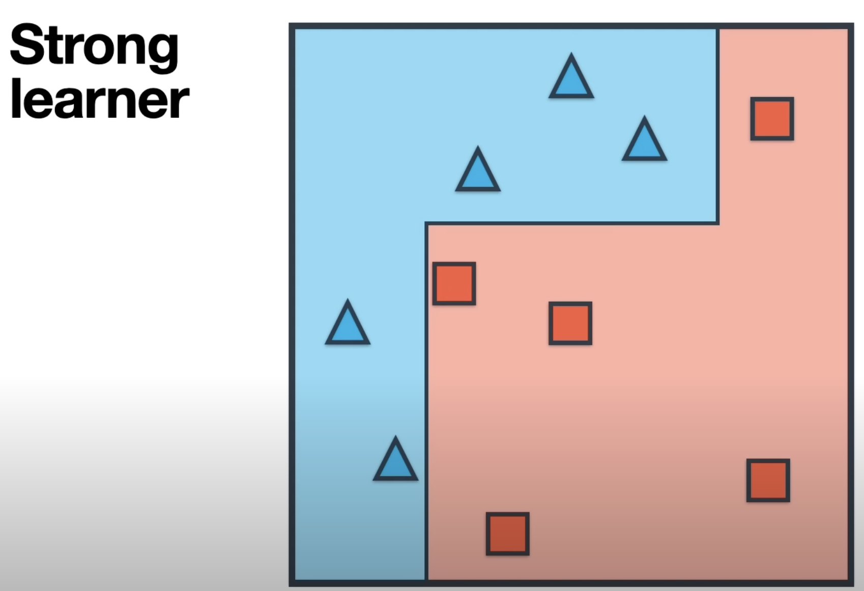
Our final step is just that we combine the three Weak Learners 1, 2,3 - to get this strong classifier over here
1
This is the Strong Learner that AdaBoost build for us, but this is the gist of Ada boost but there few details add to it such as – by how much do you scale the mistakes
2

Slide 6
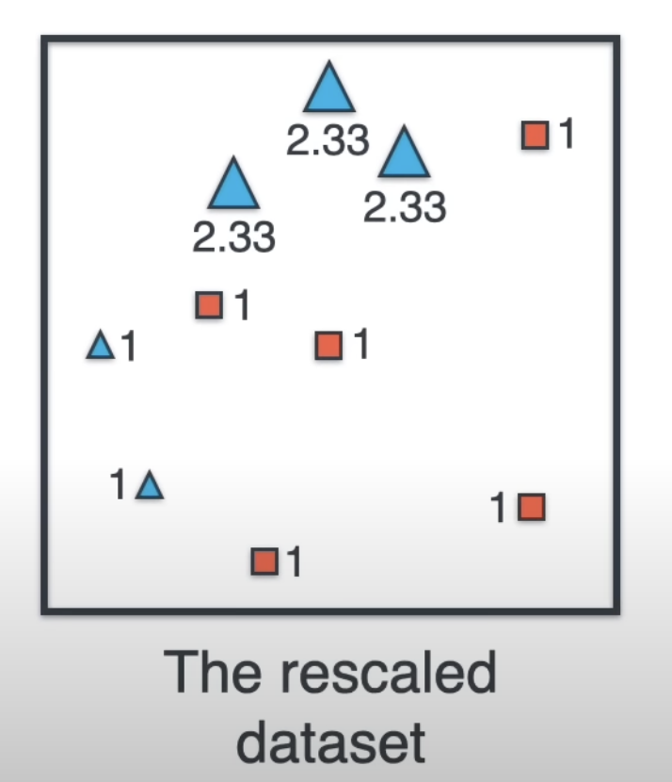
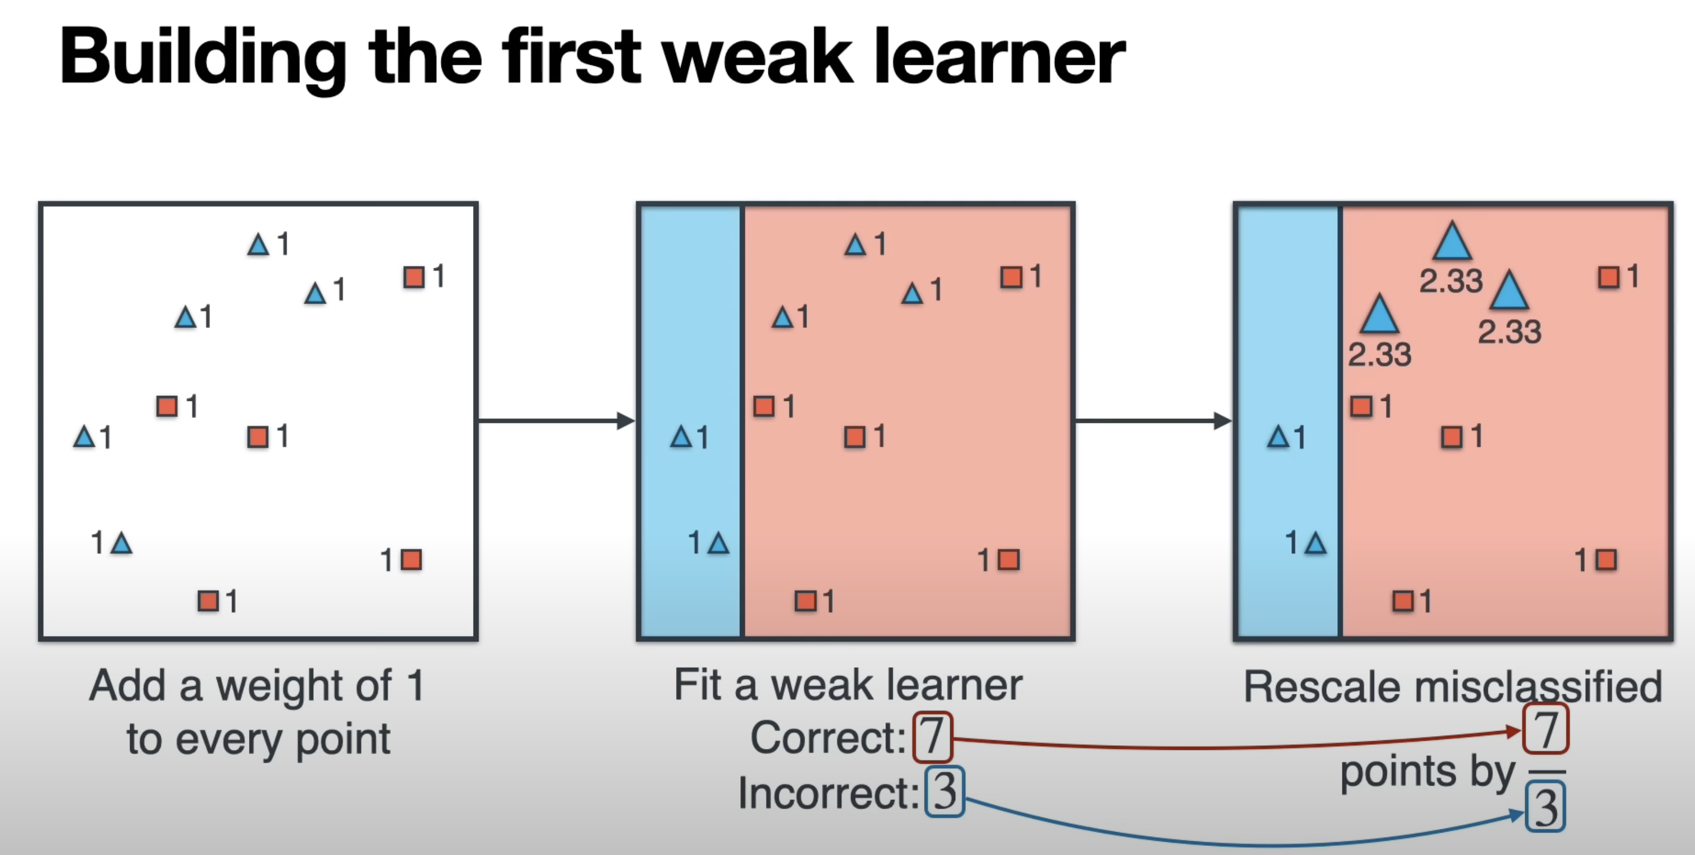
by how much do you scale the mistakes
How to you combine the classifier
or
Building Weak Learner 1
3 points which misclassified get blow up a factor of 2.33 i.e. 7/3 => 2.33
1
2
This is our rescaled data set now we are going play the same game again in order to build the 2nd weak learner

Slide 7
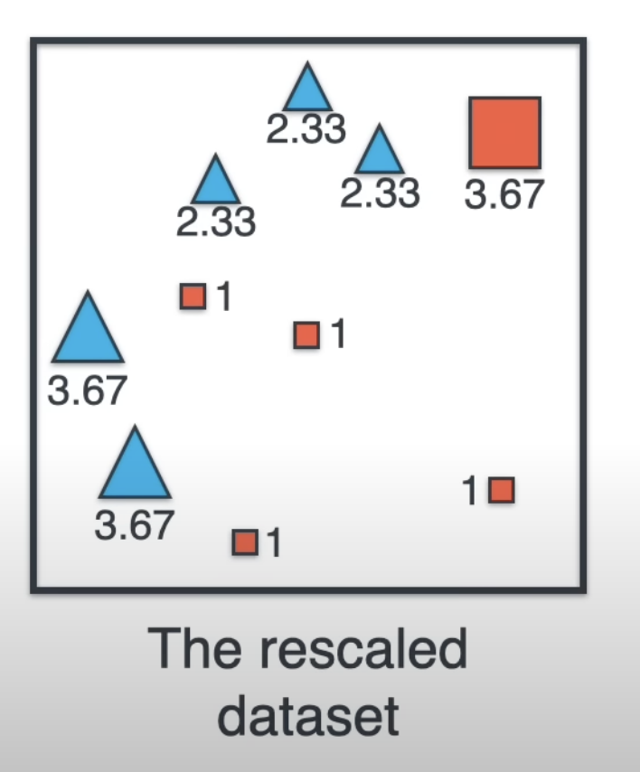
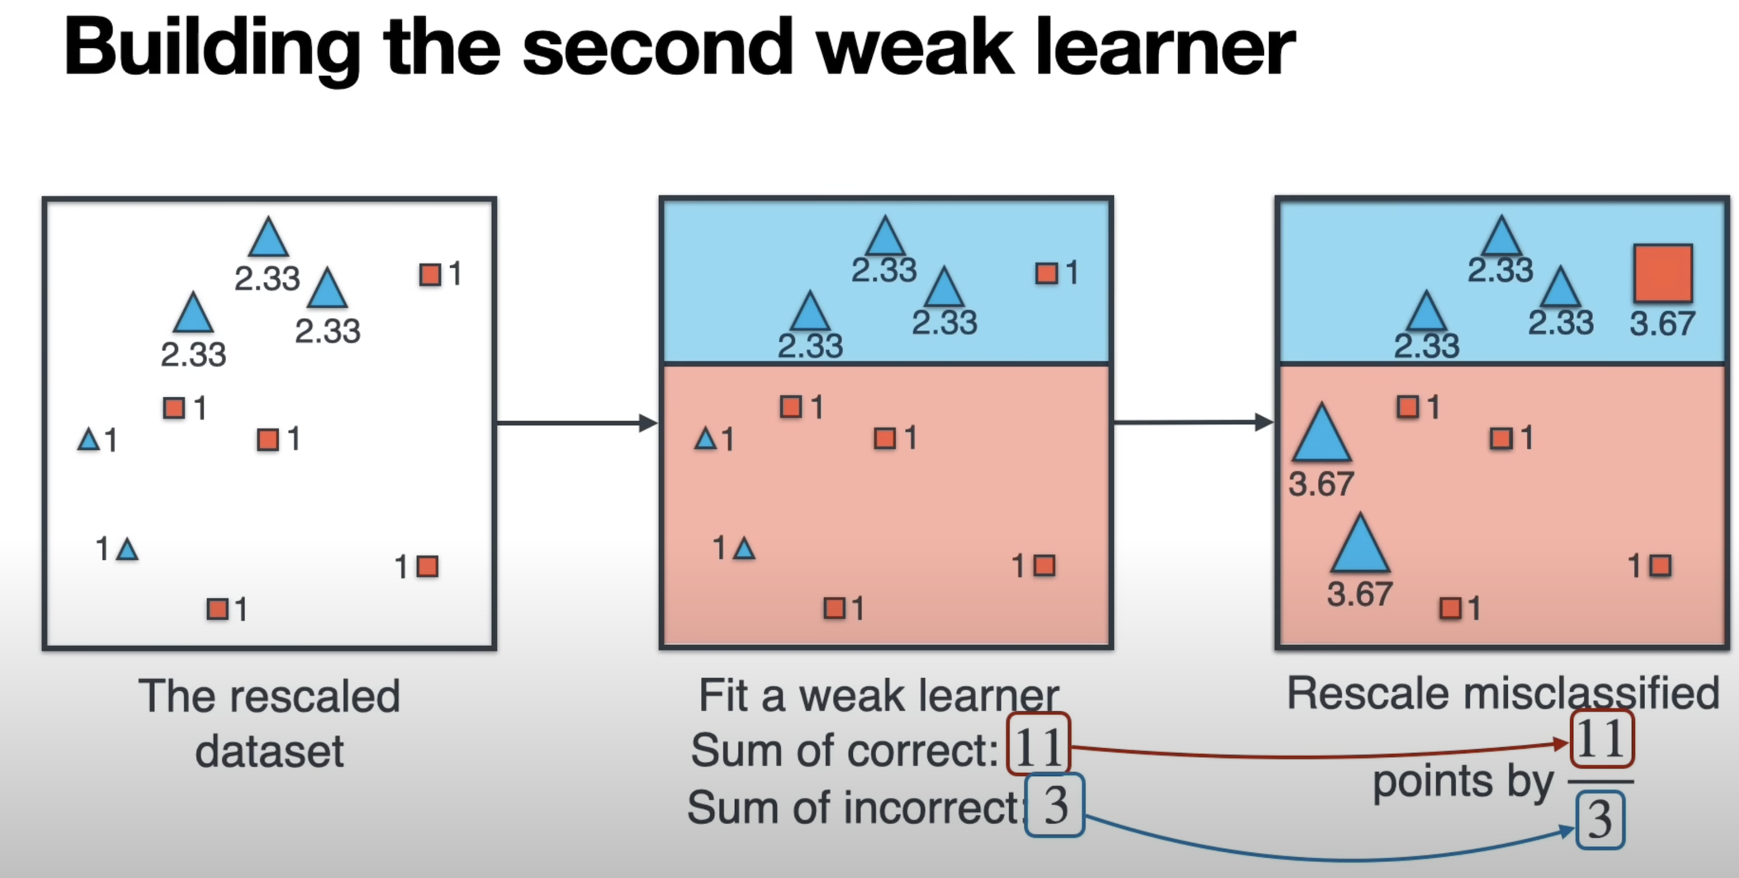
by how much do you scale the mistakes
How to you combine the classifier
or
Building Weak Learner 2
5 points which misclassified get blow up a factor of 3.67 i.e. 11/3 => 3.67
2.33 + 2.33 + 2.33 + 1 + 1 + 1 +1 => 11
This is our rescaled data set now we are going play the same game again in order to build the 3rd weak learner

Slide 8
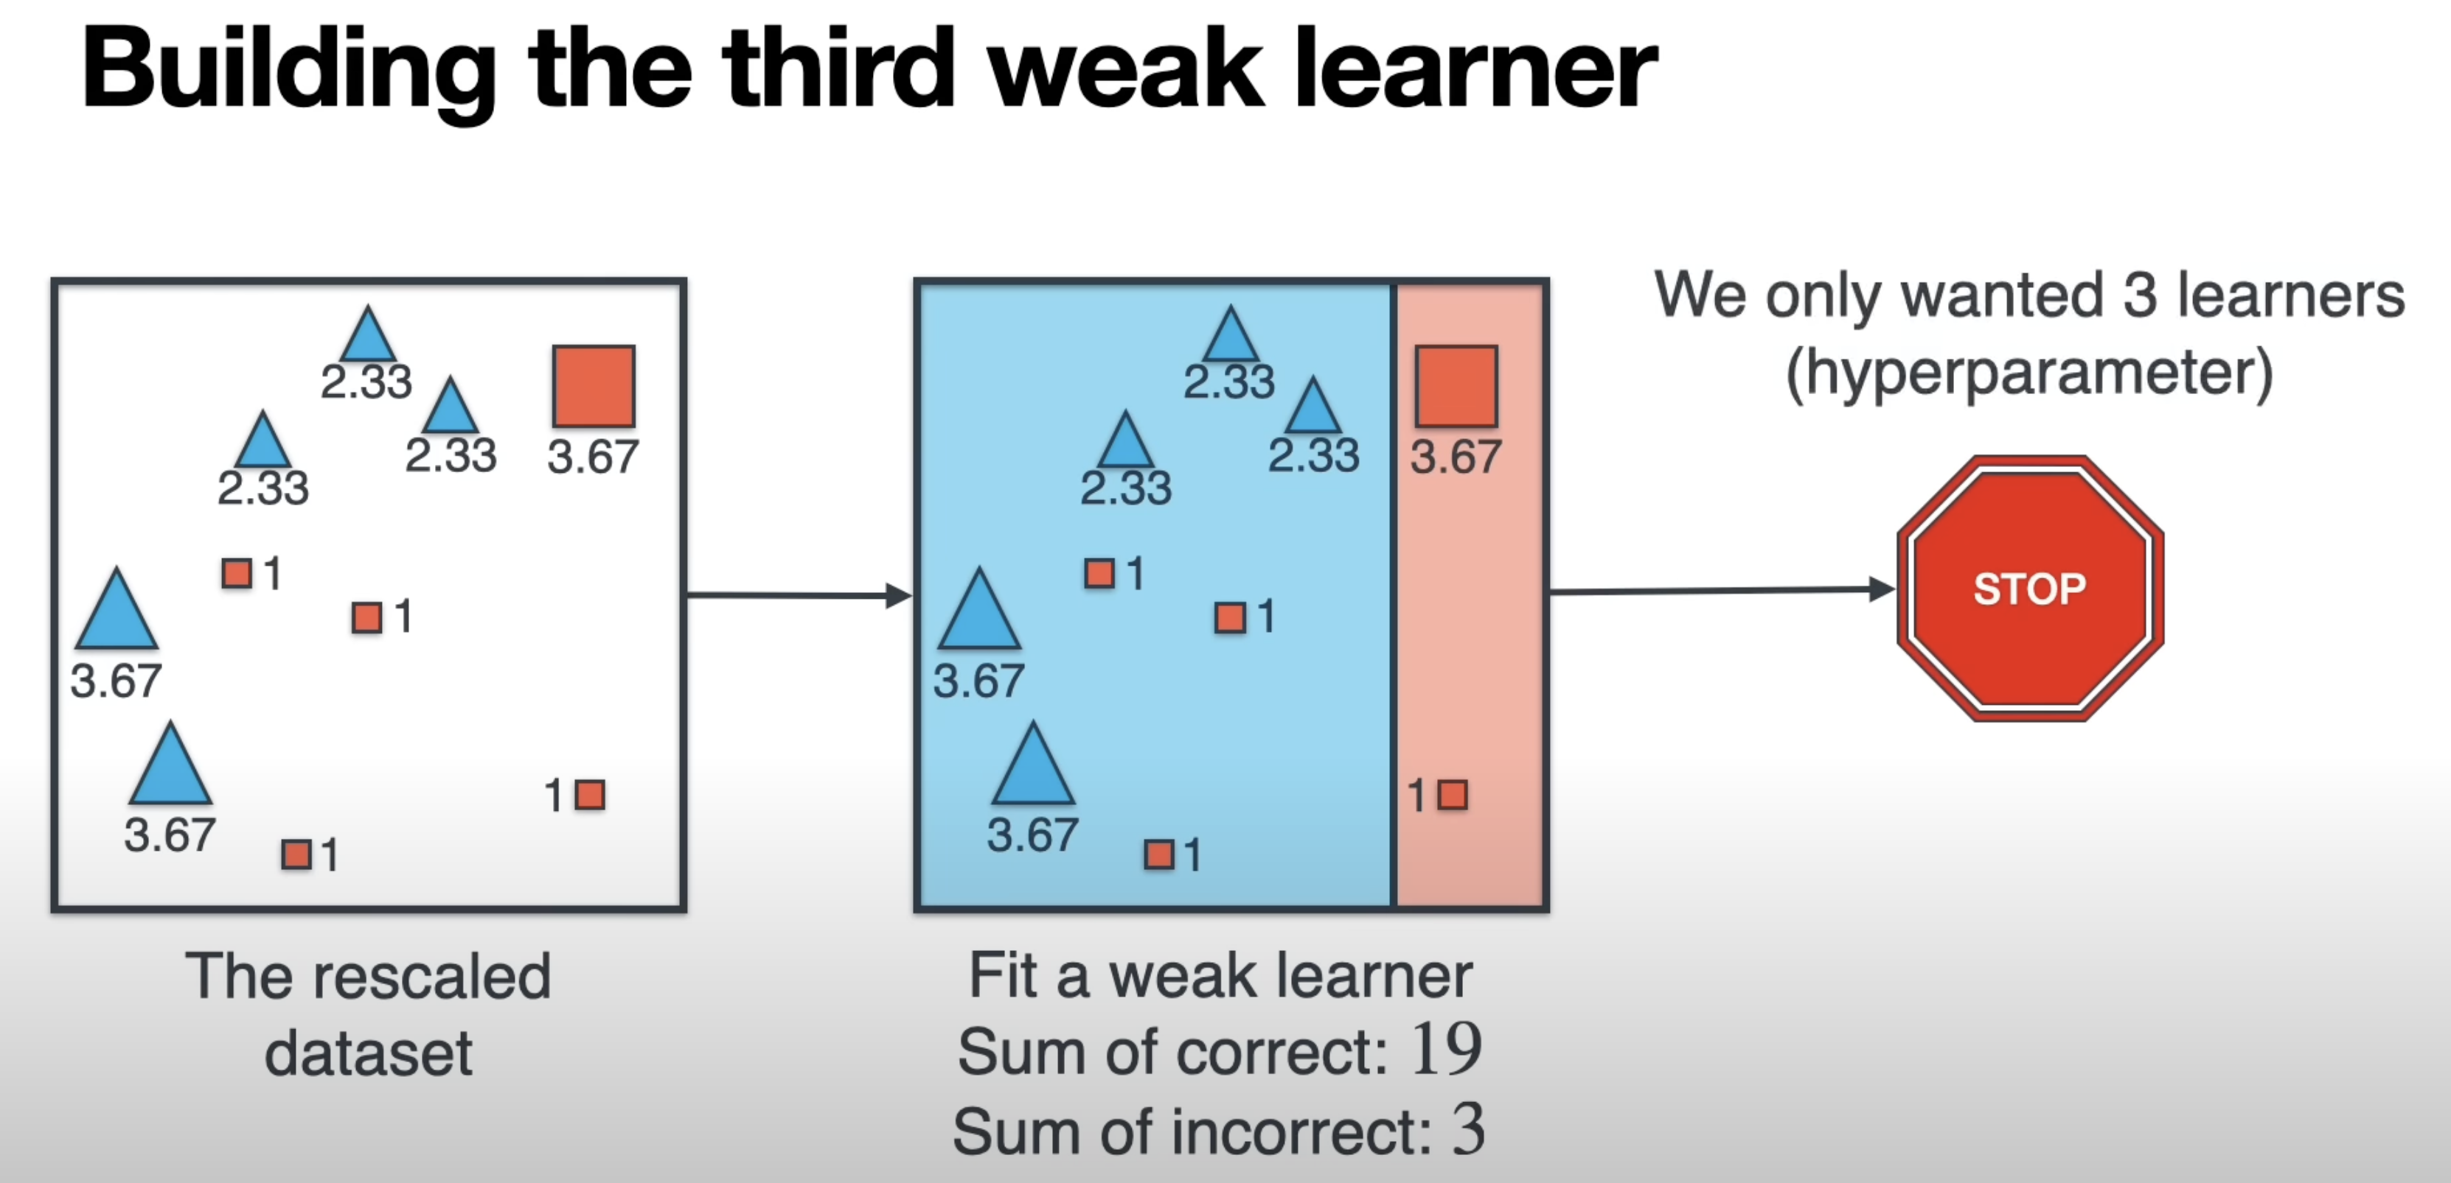
by how much do you scale the mistakes
How to you combine the classifier
or
Building Weak Learner 3
3 points which misclassified get blow up a factor of 3.67 i.e. 19/3 => 3.67
2.33 + 2.33 + 2.33 + 3.67 + 3.67 + 3.67 +1 => 19
Since we are stopping here in this case, we choose 3 classifier as hyperparameter

Slide 9
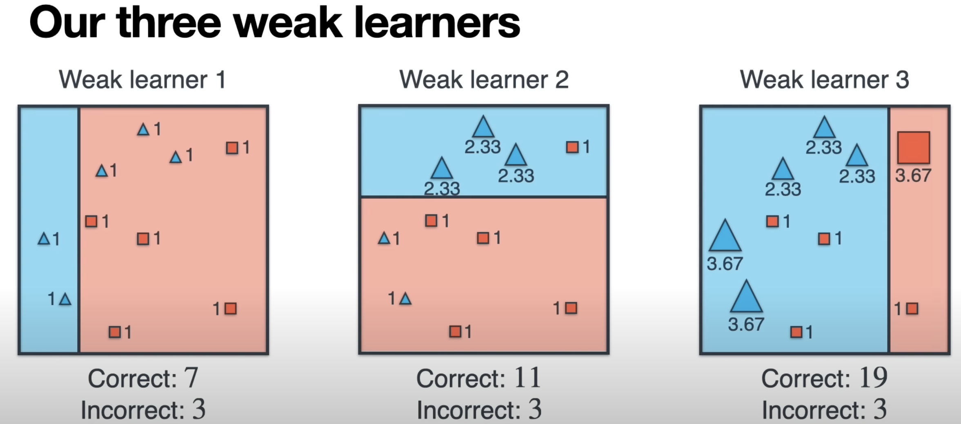
Finally, here are 3 Weak Learners
These numbers will be important when it comes to combining these three Weak Learners into a Strong Leaner which is in next slide…

Slide 10
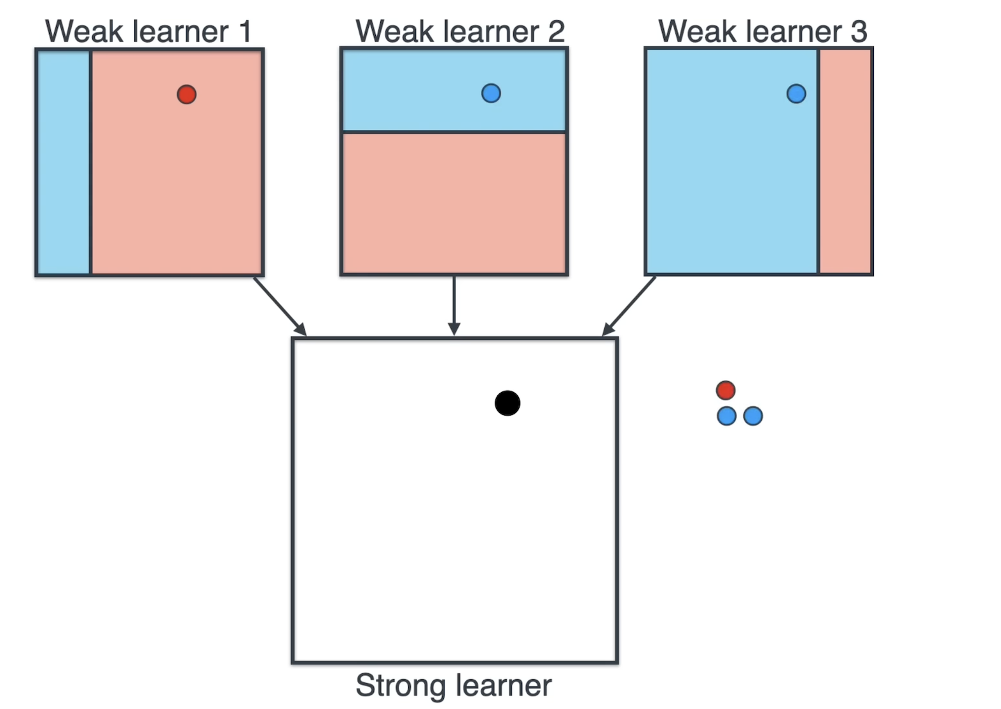
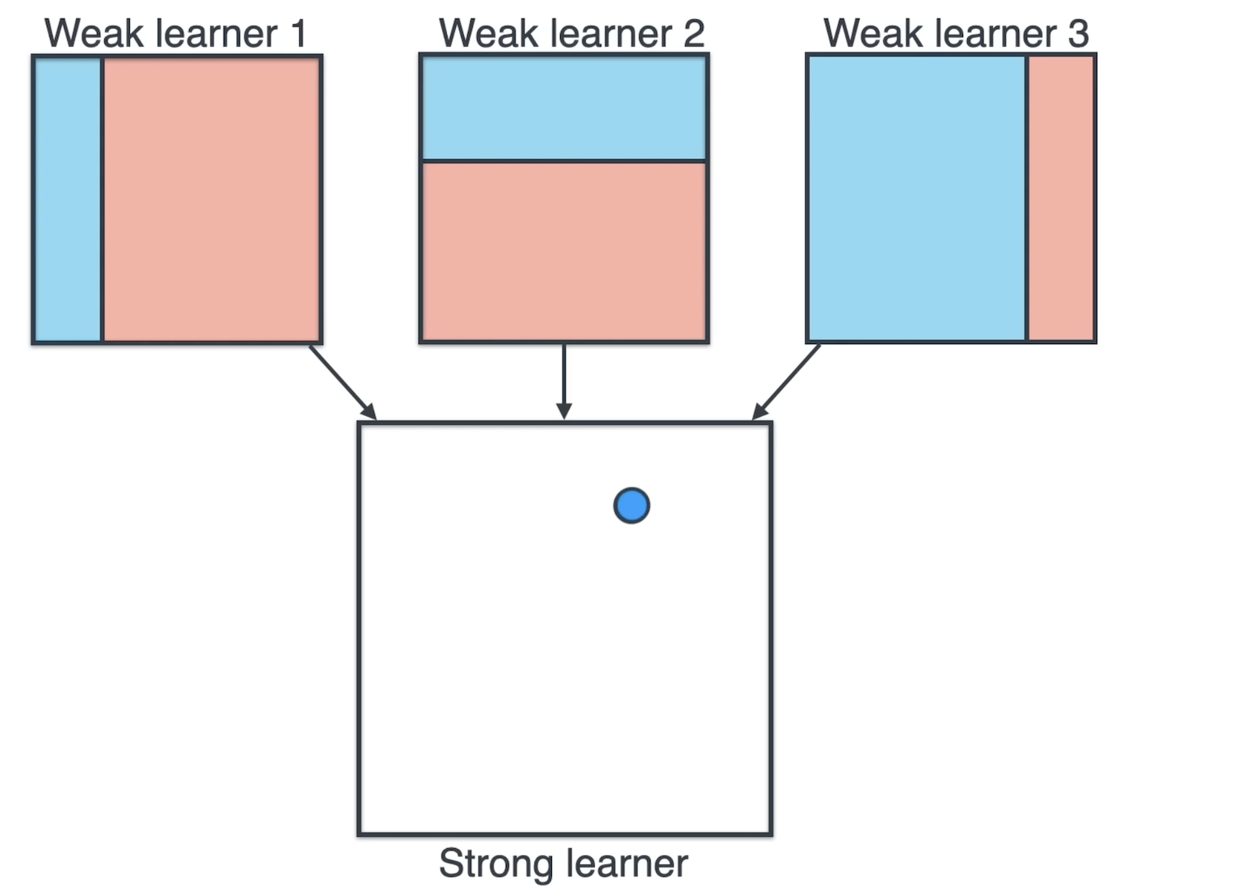
Combine the Weak Learners to Strong Leaners
Frist lets check what label is given to that point by the 3 – weak learners and the labels given are Red for the First one, Blue for the second one and Blue for the 3 one – so when we make them vote
After Voting the label is Blue
Now we will do that for every point…

Slide 11
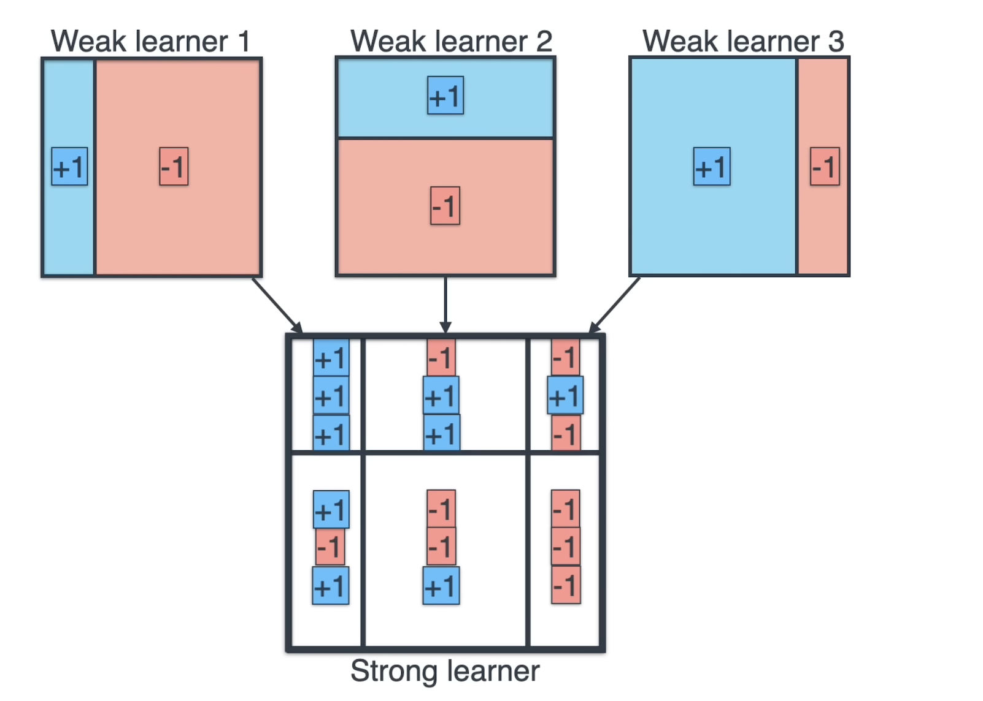
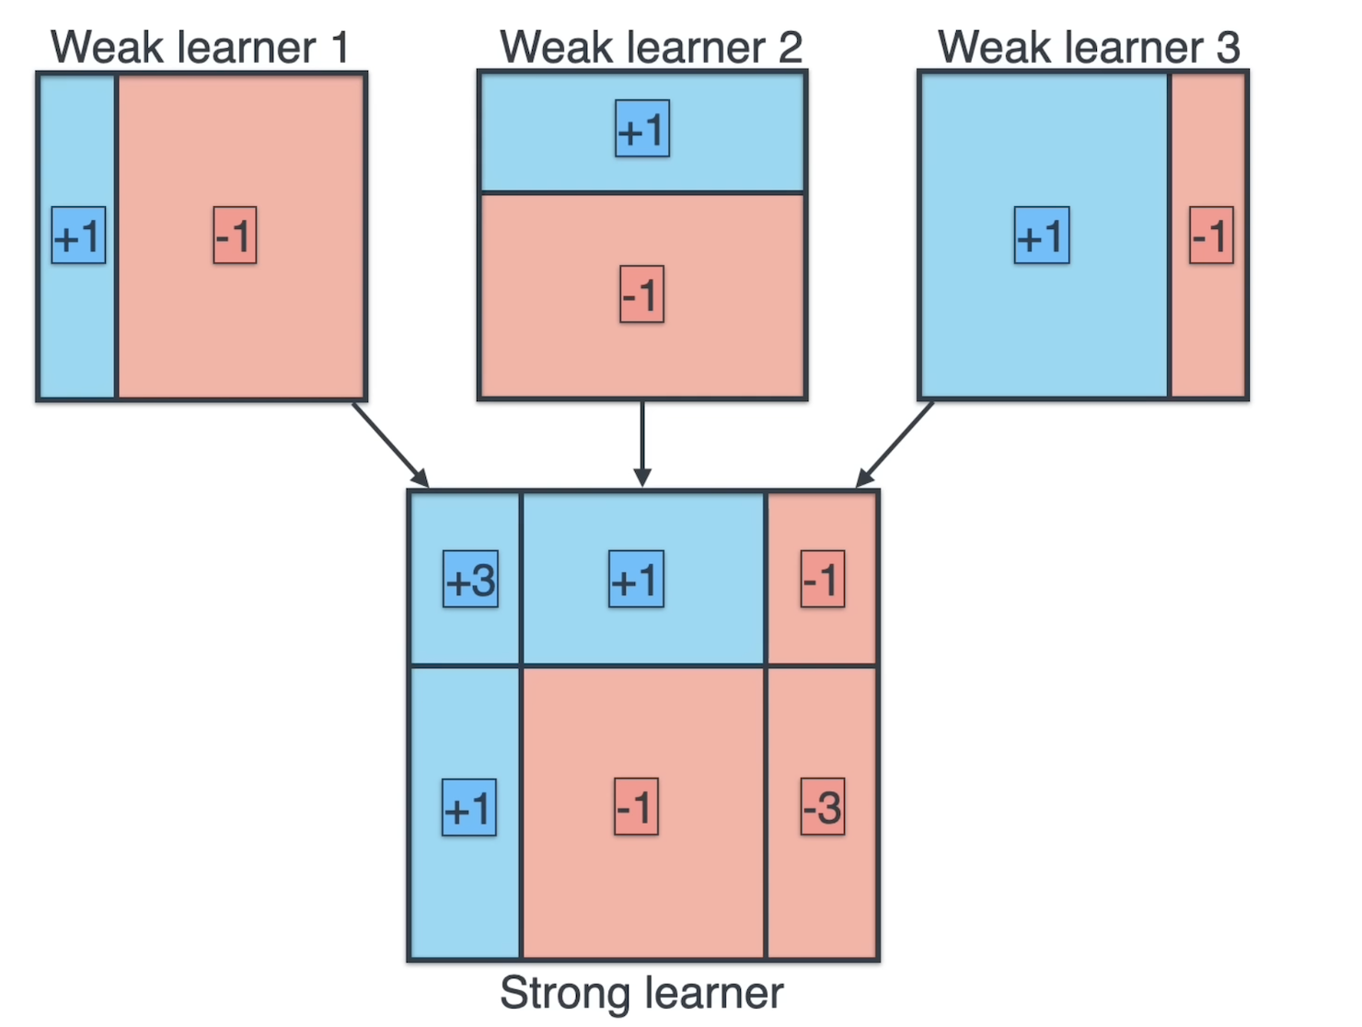
Let's put +1’s into blue regions and -1’s into red regions

Slide 12
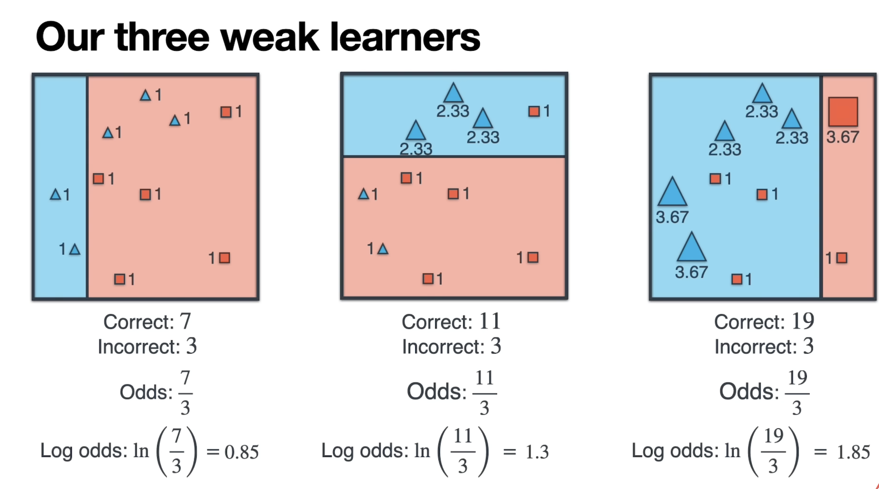
Now let's combine them using weighted voting
For the symmetrical distribution we are using Logarithmic

Slide 13
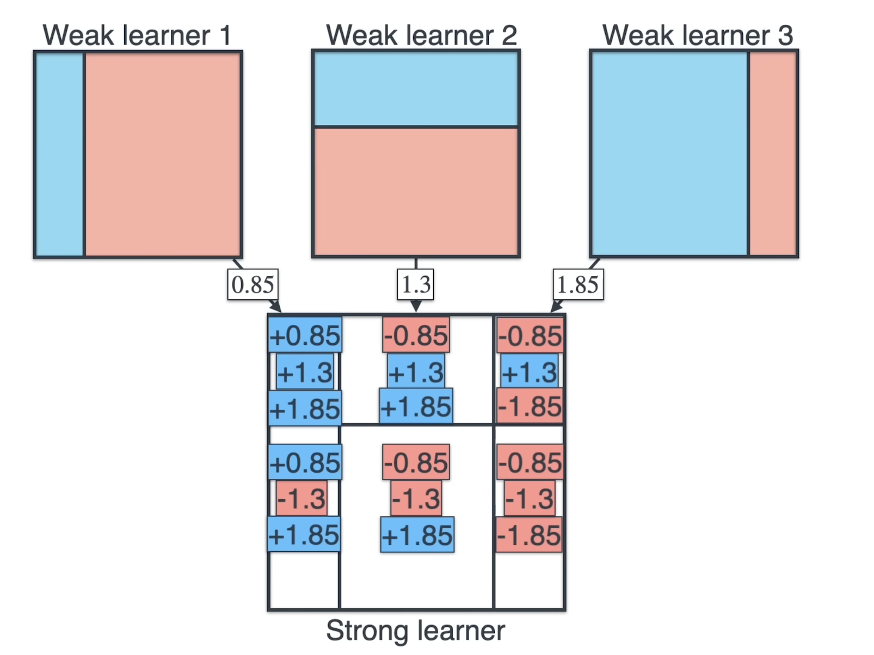
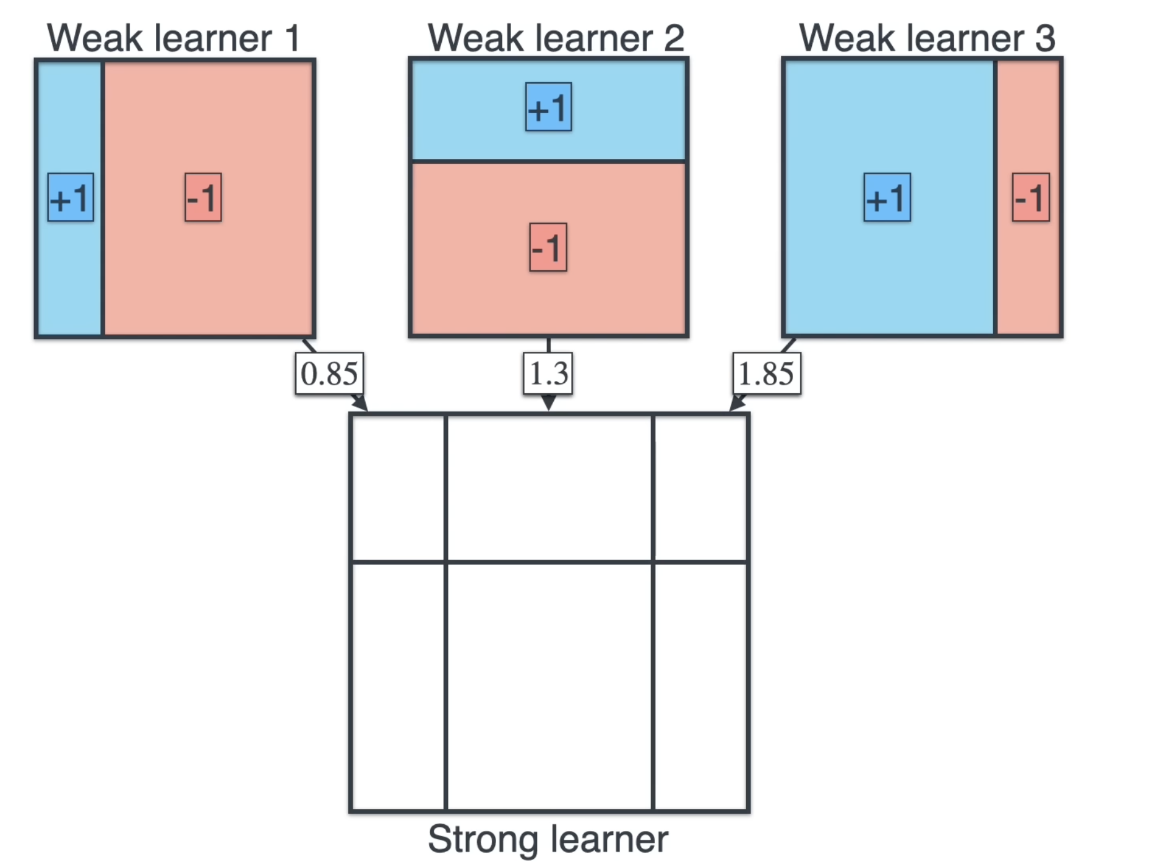
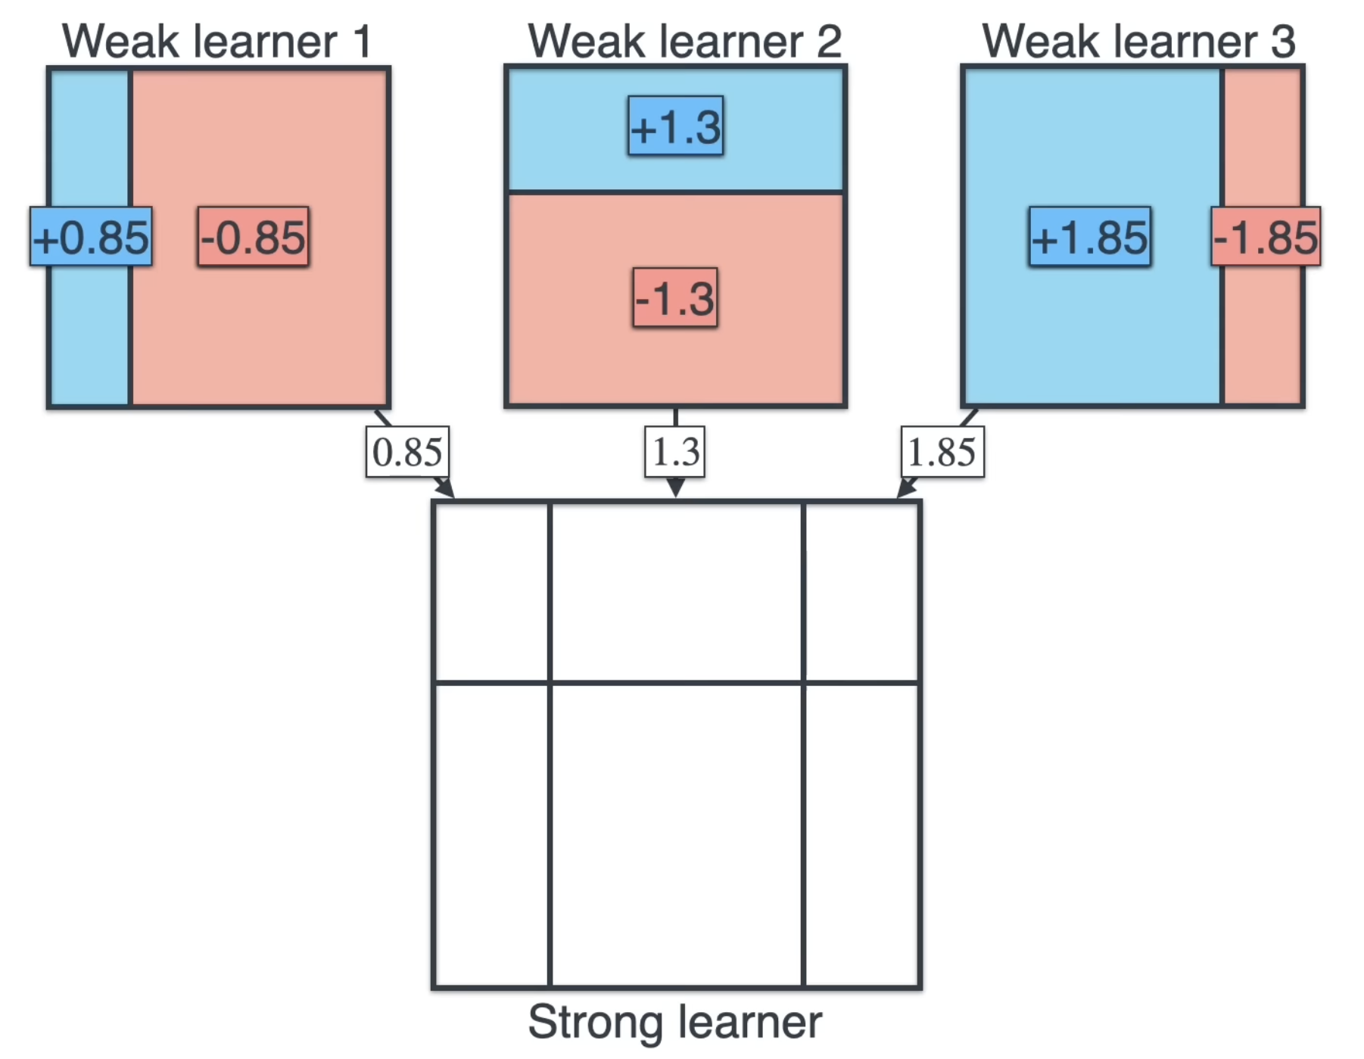
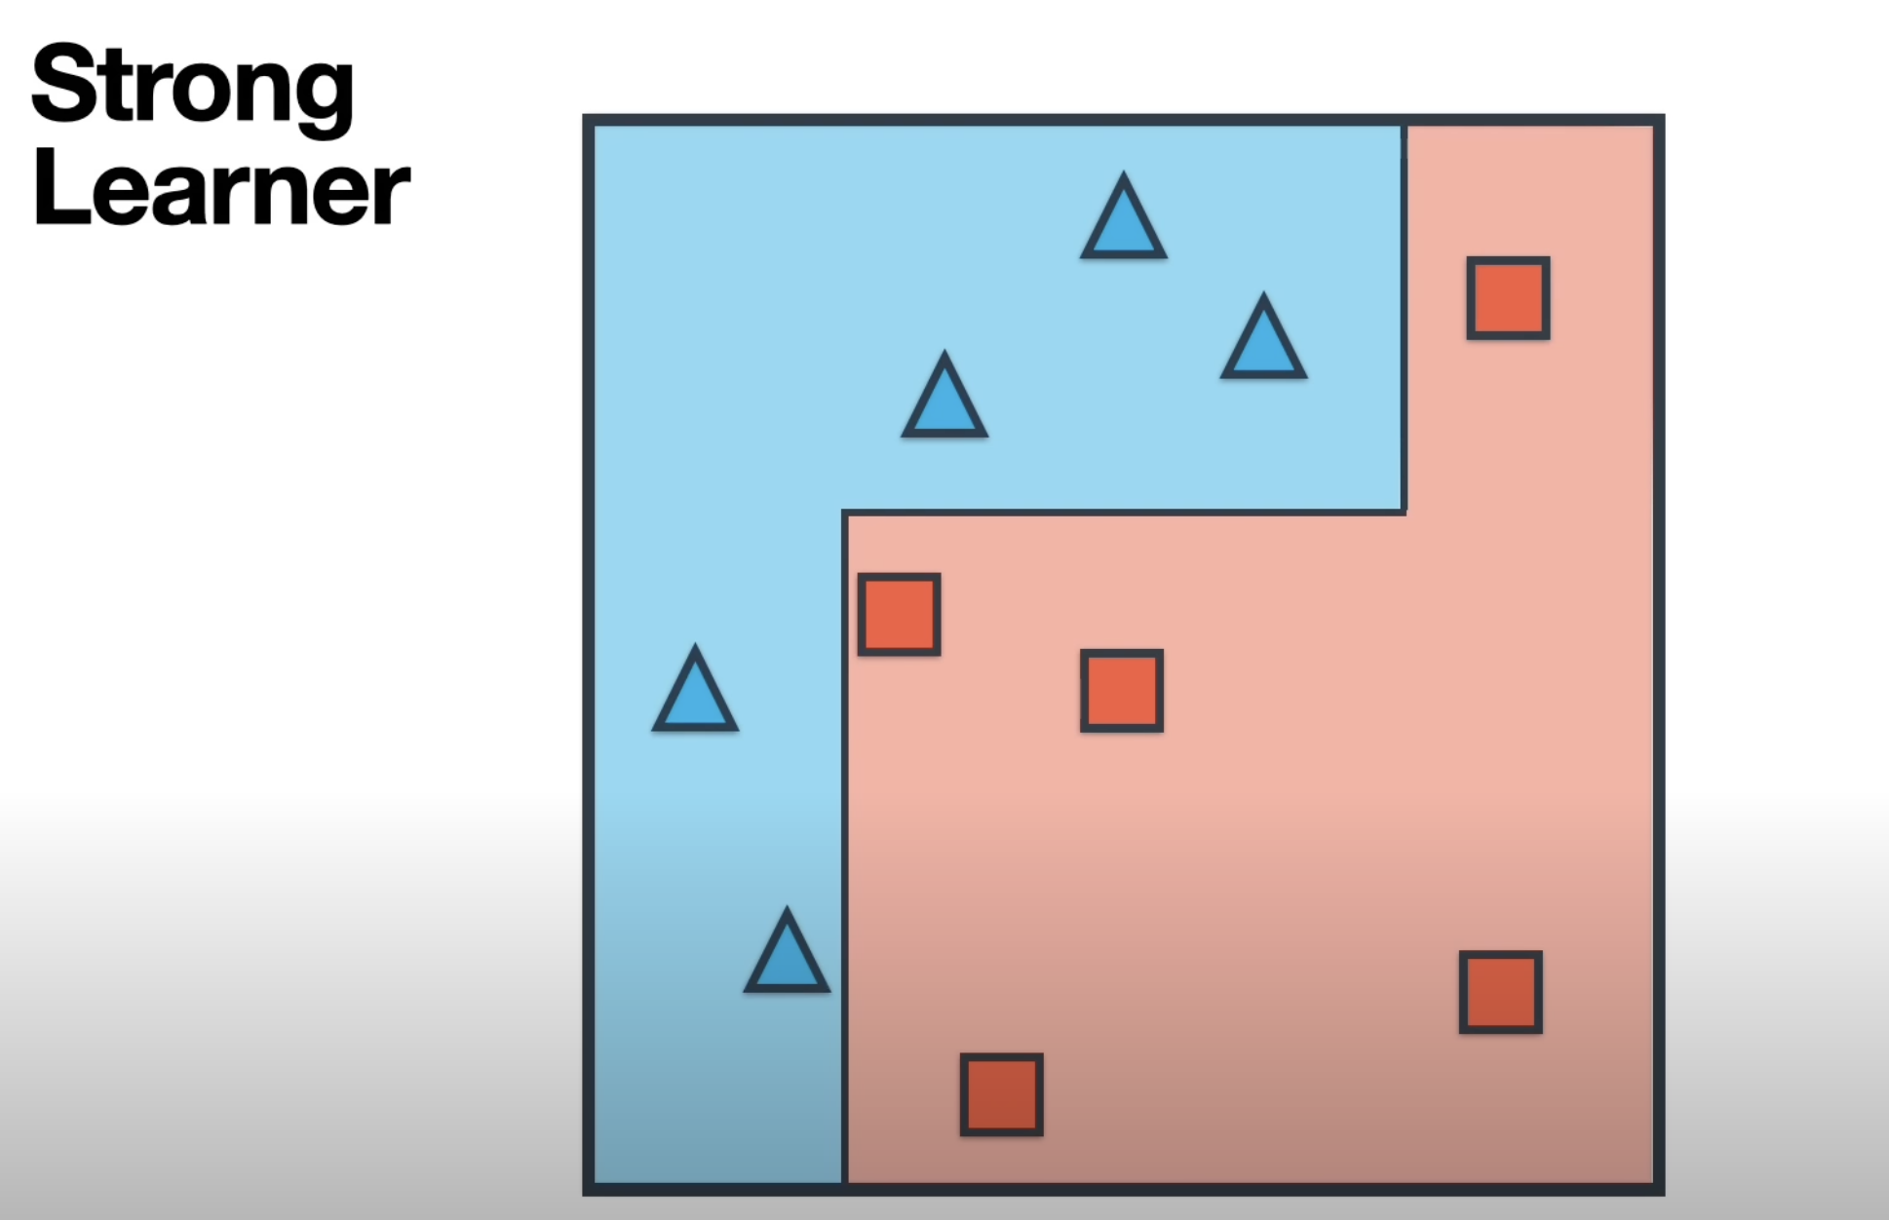
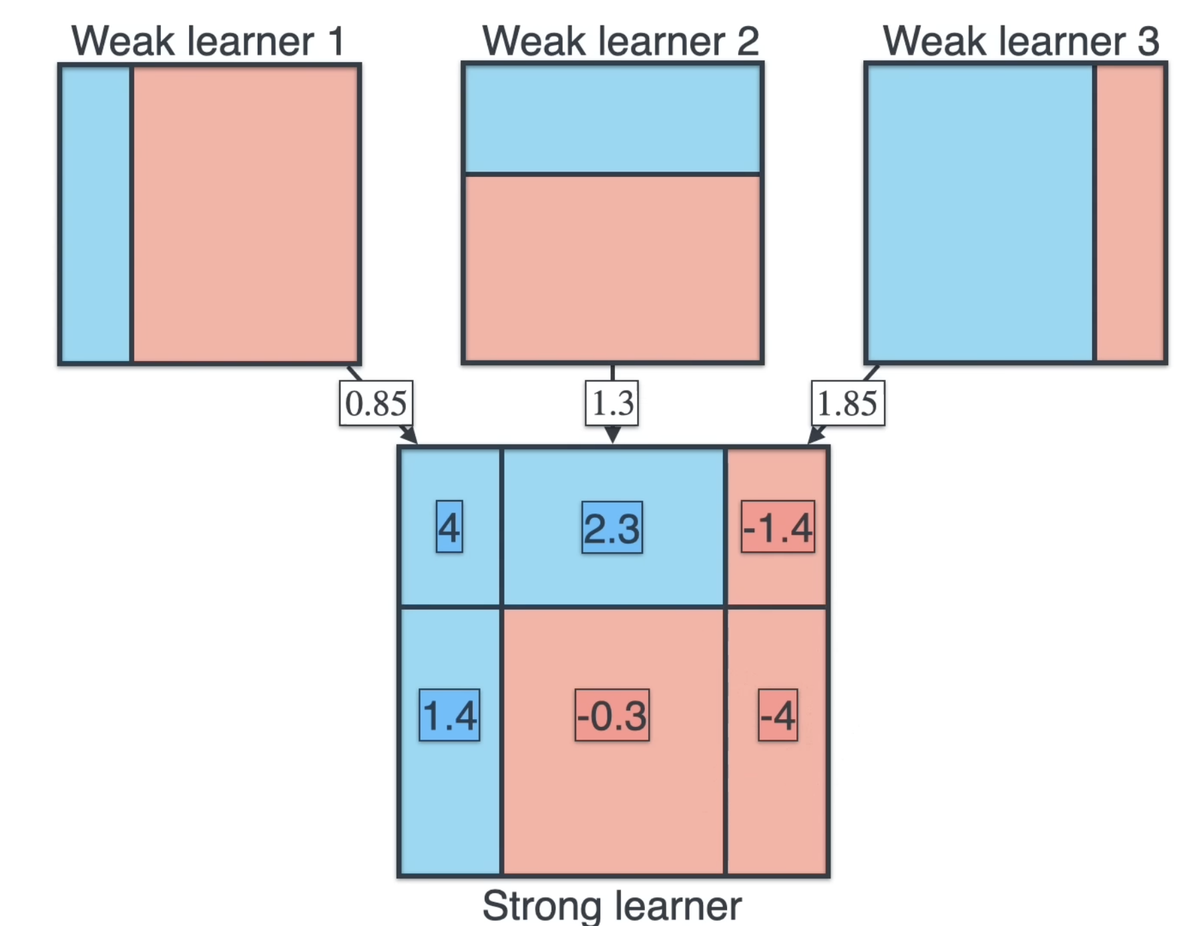
Now we are multiplying with +1’s and -1’s with assigned weights before with quality score of each one of the weak learners - After combining the all the 3 weaker learners it combines the Strong learner.
1
2
3
Notice that this stronger leaner does well because it manages to classify the entire data set correctly
4
5

